Slide 1
Catenary Program
11 January 2019

Slide 2
Catenary Folder Structure
dataManager
Input files .yml files
CatenaryMethods.py
Calculation done in method.py
CatenaryRiser.py
Runthe program with default yml files
Results
Out put file will save in these folder

Slide 3
CatenaryMethods.py Structure
Catenary Equation defining
Catenary Force
SagHog Equation defining
Generating the plot
Lazy wave catenary equation
LazyWave plot Defining
Buoyancy properties

Slide 4
CatenaryResults.py Structure
Defining the Build Model for SLWR
Defining the Build Model for SCR
Data Preparation
Evaluating the sectionproperties
Lazywave Analysis
Construct FEA Model

Slide 5
CatenaryMethods.py Structure
Catenary Equation defining
Calculating the horizontal distance , chain weight , catenary shape.
Catenary Force
Calculating the vertical load, Total Force, horizontal force along catenary.
Calculating the bendradius for
sag to buoyancy configuration.
Buoy to Hog Configuration,
Hpg to Buoyancy Configuration
Buoy to touch down
SagHog Equation defining

Slide 6
CatenaryMethods.py Structure
Defining the Hang-off to sag Section
Taken the data from catenary equation and updated the result .
Summarized the lazy wave catenary
Defining the Hang of Buoyancy
Defining the Buoyancy
Defining the Buoyancy to touchdown
.
LazyWave Catenary Equation Defining
Defining the Hang-off to sag Section
Buoyancy section
Buoyancy section to touch down
LazyWave plot Defining
Generating the plot

Slide 7
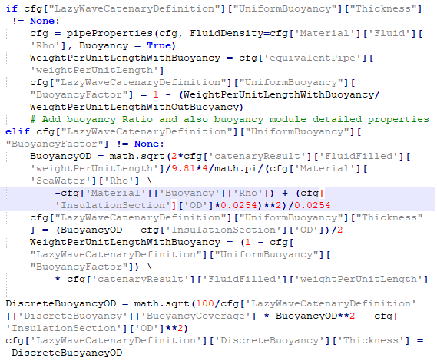
CatenaryMethods.py Structure
Defining the Buoyancy Properties

Slide 8
CatenaryRiser.py Structure
import sys
import math
import logging
import oyaml as yaml
#import ruamel.yaml
from math import *
# from catenarycalculation import *
from dataManager.ymlInput import ymlInput
from dataManager.customUpdate import customUpdate
from results.saveData import saveDataJson, saveDataYaml, saveDataFrame
from catenaryMethods import catenaryEquation, catenaryForces
from catenaryMethods import buoyancyProperties, lazyWaveCatenaryEquation, lazyWavePlot
from pipeProperties import pipeProperties
from pipeProperties import buoyancyFactorAndDiameter
from orcaflexModel import orcaflexModel, WriteOrcaflexModel
from logs.setLogging import setLogging
Importing the modules

Slide 9
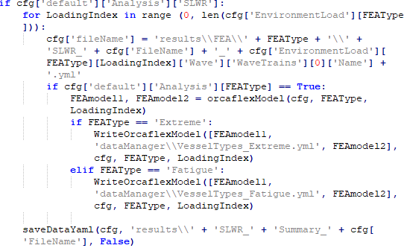
CatenaryRiser.py Structure
Building the model for SLWR
Building the model for Extreme and Fatigue Analysis
Defining the Build Model for SLWR

Slide 10
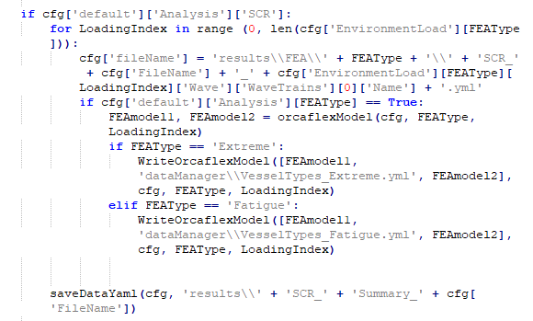
CatenaryRiser.py Structure
Building the model for SLWR
Building the model for Extreme and Fatigue Analysis
Defining the Build Model for SCR

Slide 11
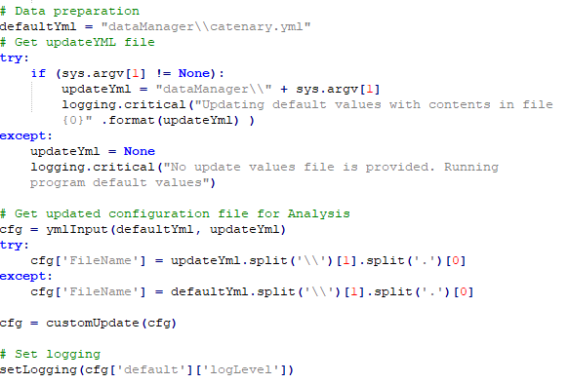
CatenaryRiser.py Structure
Data Preparation

Slide 12
CatenaryRiser.py Structure
Calling the input data for catenary equation
Evaluating the Section properties
Calling the pipe properties
Fluid Density, Seawater.

Slide 13
CatenaryRiser.py Structure
Buoyancy Properties
Lazy Wave Analysis
Lazy wave inputs.
Lazy wave inputs.
Update the lazy wave catenary result

Slide 14
CatenaryRiser.py Structure
Construct FEA Model
Pipe Properties Buoyancy section,

Slide 15
Way Forward
Buoyancy properties are called two times .
Only pipe properties were updating.

Slide 16
THANK YOU
For the opportunity to serve!

Slide 17
Document Revision History
01 | New document | 16 June 2016 |  | VA
Rev | Description | Date |  | Author | Checked | Approved
Document No: |  |  | Client Ref:
0132-PRE-0001-01 |  |  | n/a

